Slide 1
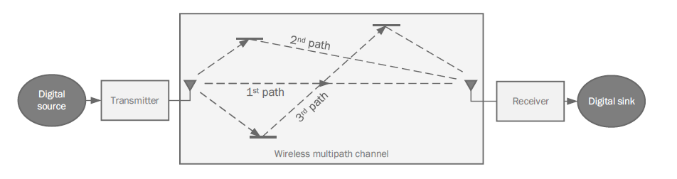
Inter-Symbol interference due to multi-path channel

Slide 2
In wireless channels, signals are transmitted via electromagnetic waves which propagate through the air until it reaches the receiver.
However, the nature of electromagnetic waves allow that multiple copies of the signal would travel around and reach the receiver at different times, such as is shown in above .
This effect is what is known as the multipath effect. As is shown in the figure.
A symbol transmitted by the transmitter would traverse multiple paths until it reaches the receiver.
Therefore, the receiver is expected to receiver multiple copies of the same transmitted signal.
Each of these copies would arrive at a different time (based on how long the path that the signal travelled through is) and with a different magnitude (based on how much attenuation that the signal suffered from during the transmission across the path).

Slide 3
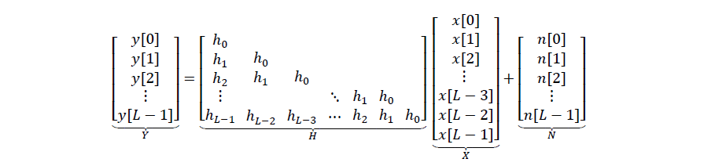
The figure below is the relation bn input seq x and the received y with signal noise N and channel effect (attenuation) H.
Fig 2
For simplicity we will write this
equation as 𝑌 = 𝐻𝑋 + 𝑁.
The transmitted signal is 𝑋. This is what the receiver wants to know or estimate.
The received signal is 𝑌. This is what the receiver measures from the channel, and is the main observation from which the receiver can figure out what 𝑋 is.
The noise component 𝑁. This corresponds to the AWGN noise which corrupts 𝑌.
The channel coefficients 𝐻. This term captures the effect of the channel on the transmitted symbols passing through different paths. There are mechanisms which allow the receiver to estimate the value of 𝐻. So we can safely assume that 𝐻 is known at the receiver.
Our goal here is to find out and plot the relation bn BER and Eb/No .

Slide 4
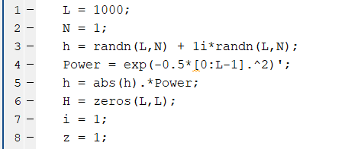
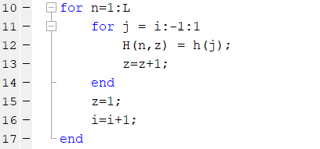

So how to get this relation ??
First way
we will get a solution for this equation 𝑌 = 𝐻𝑋 + 𝑁. So we want to find out X , H and N
1- we assume L = 1000 where L is the number of paths and also
number of bits. We want to create H as it’s complex gaussian with
zero mean and unit variance which is normal dis .
First we get h then get the power of the normal dis then multiply
mag(h)*power. Lines[1 : 5]
2- Then we will create H zero matrix then fill it to make it lower tri
matrix as fig 2. Lines[10 : 17]
3- Then we will get inversed H to received bits out of Y , create 2
empty matrices BER and BER_Temp , identify Eb = 1 and assume the
of No. Lines[19 : 23]

Slide 5

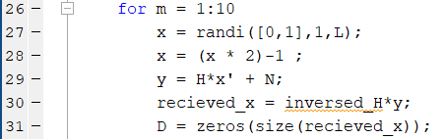
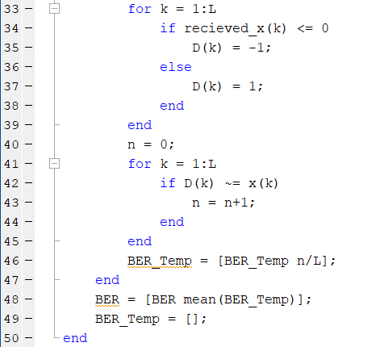

4- get N noise same as H by multiply power by mag. Lines[24 : 25]
5- for each value of No we will loop 10 times to get 10 values of BER
and get the value of x by get a random seq of 0’s and 1’s then use the
in line 28 to get x as BPSK. Then calculate the eqn to get Y and
multiply inv of H we got before by Y to get the received bits then
create zero matrix of the same size of received x and then fill it by
comparing if the received bit <= 0 then D(k) = -1 else it will equal 1.
compare D(k) by x(k) to figure out if there is error or not
if error then n = n +1 else n won’t change. Lines[26 : 45]
6- then fill BER_temp in each loop then use these 10 values to get
the BER by getting their average in each outer loop. Lines[46 : 50]
7- and now after getting BER and No then we will plot the relation bn
BER and Eb/No. Lines[52 : 54]

Slide 6
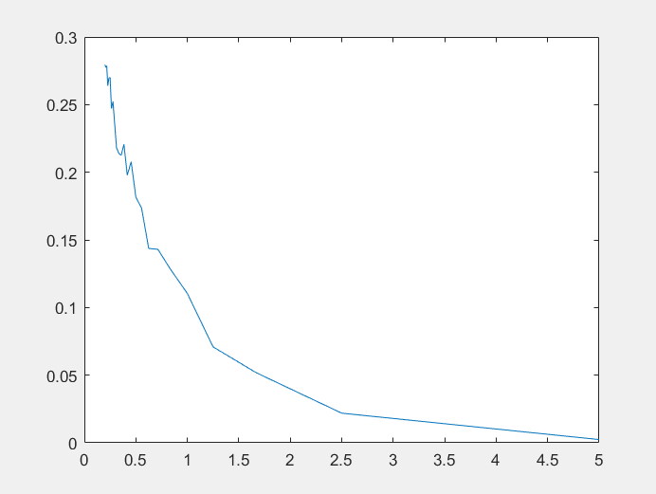
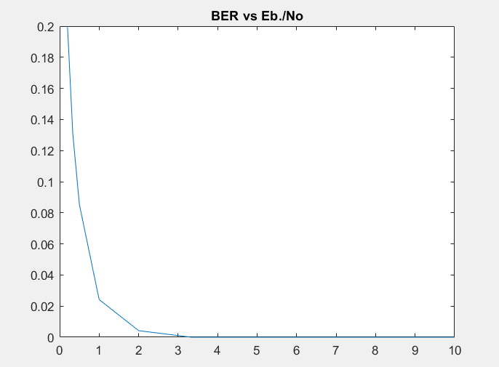
The relation bn BER and Eb/No is an inverse relation as the noise decreases the BER decreases.

Slide 7
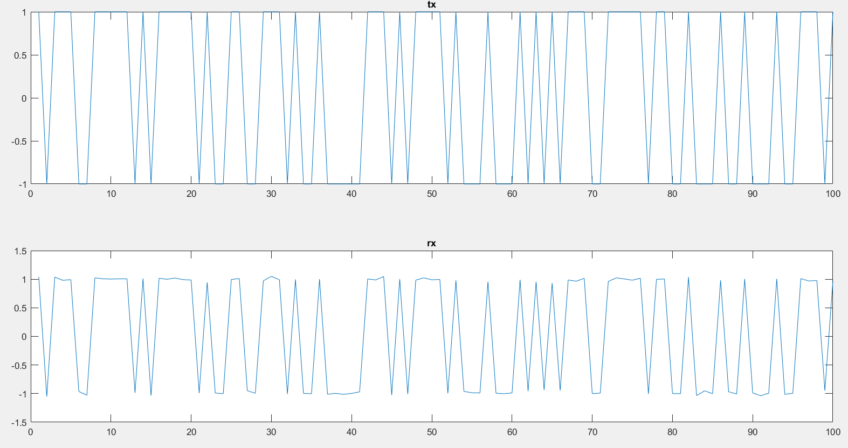
Relation bn transmitted bits and received bits as obvious the received bits are a little bit different from the transmitted due to presence of noise in the channel.

Slide 8
Second way
𝑦[0] = ℎ0𝑥[0] + 𝑛[0]
𝑦[1] = ℎ0𝑥[1] + ℎ1𝑥[0] + 𝑛[1]
𝑦[2] = ℎ0𝑥[2] + ℎ1𝑥[1] + ℎ2𝑥[0] + 𝑛[2]
⋮
𝑦[𝐿 − 1] = ℎ0𝑥[𝐿 − 1] + ℎ1𝑥[𝐿 − 2] + ℎ2𝑥[𝐿 − 3] + ⋯ + ℎ𝐿−2𝑥[1] + ℎ𝐿−1𝑥[0] + 𝑛[𝐿 − 1]
By using this set of equations we can estimate mathematically the value of X’ as X’ is the detected value
This receiver based on that we will detect the first sample from the first received as :
y(0)=h(0,0)*x(0)
So we can say that : x'(0)=y(0)/h(0’0)
Then we will decide the value of it as :
If x'(0)<0 --> detected=-1
If x'(0)>0 -->detected=1
Then to detect the second sample we will use the received sample and also the detected value of the previous sample as:
y(1)=h(1,0)x(0) + h(1,1)*x(1)
Then we can say that:
x'(1)= ( y(1)-h(1,0)*x(0) ) / h(1,1)
And the third sample will be detected from the third sample of the output and the previous two detected samples and so on...

Slide 9
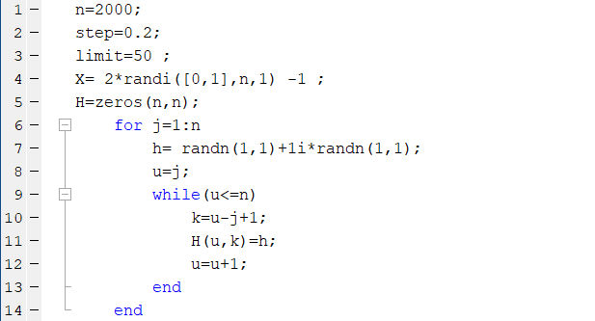
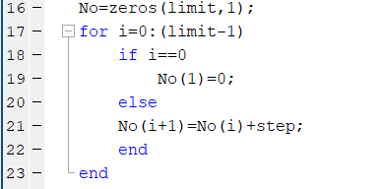
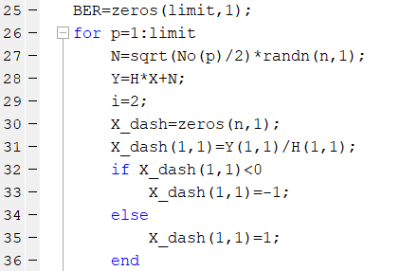
1- n is the number of samples , step and limit are used to the
values of No and X is the transmitted seq of samples as BPSK
Lines[1 : 4]
2- create H then fill as a lower tri matrix as fig 2.
Lines [5 : 14]
3- create No and set initial value to zero , step=0.2 & end = 50
Lines[16 : 23]
4- create BER as zero matrix get the value of noise as previous
solve eqn 𝑌 = 𝐻𝑋 + 𝑁 and get Y then get X’ which is the
detected signal then compare X’ with zero if less than zero
then = -1 else 1. Lines[25 : 36]

Slide 10
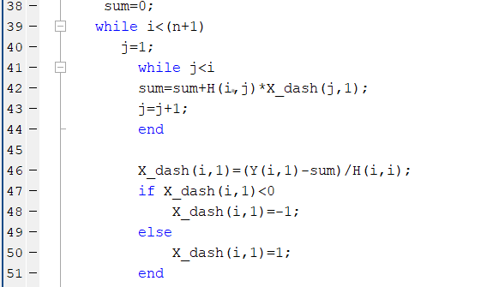
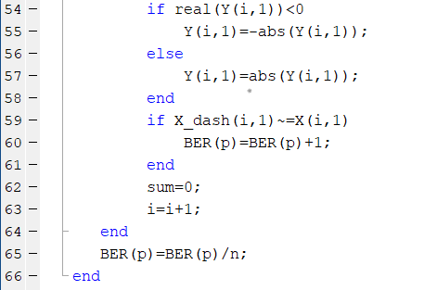
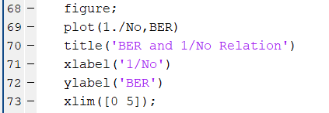
5- 𝑦[𝐿 − 1] = ℎ0𝑥[𝐿 − 1] + ℎ1𝑥[𝐿 − 2] + ℎ2𝑥[𝐿 − 3] + ⋯ + ℎ𝐿−2𝑥[1] + ℎ𝐿−1𝑥[0] + 𝑛[𝐿 − 1]
In the previous equation the term sum represents
attenuation due to channel coefficients which increases
with time . Here we get a solution for the previous
equation
then compare X’ with zero if less than 0 then equal -1
else equal 1 Lines[38 : 51]
6- Here we compare the received signal Y with zero to be
able to compute BER by comparing Y(received) with X’
(detected). Lines[54 : 66]
7- At the end we plot the BER vs Eb/N0 Lines[68 : 73]

Slide 11
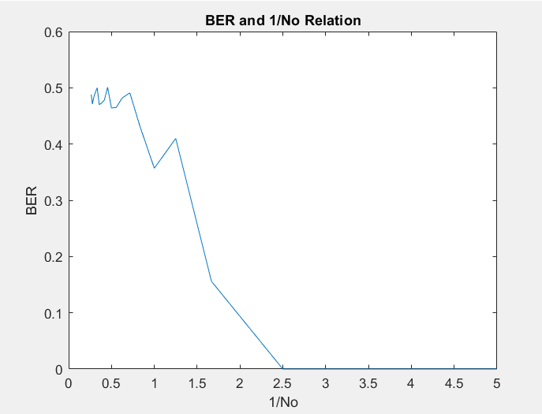
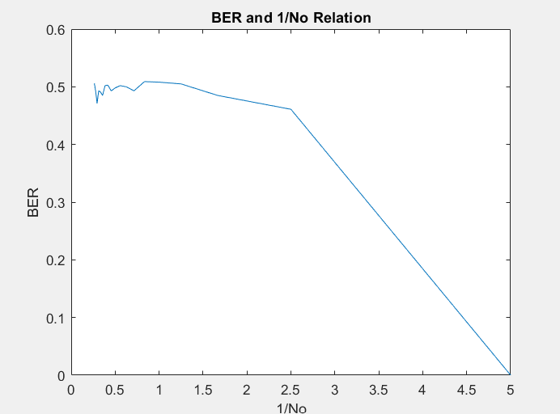
The relation bn BER and Eb/No is an inverse relation as the noise decreases the BER decreases.

Slide 12
In conclusion :
The first method is better than the second one by observing bit error rate .
Due to the accommodation of the error that is caused by the channel Coefficients which is not handled perfectly in the second method.

